Slide 1
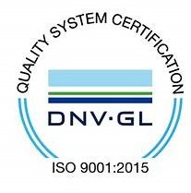
Subject Code: SCS1205 Subject Name: Object Oriented Analysis and Design Faculty Name: Dr. R. M. Gomathi/Dr. Jeberson

Slide 2
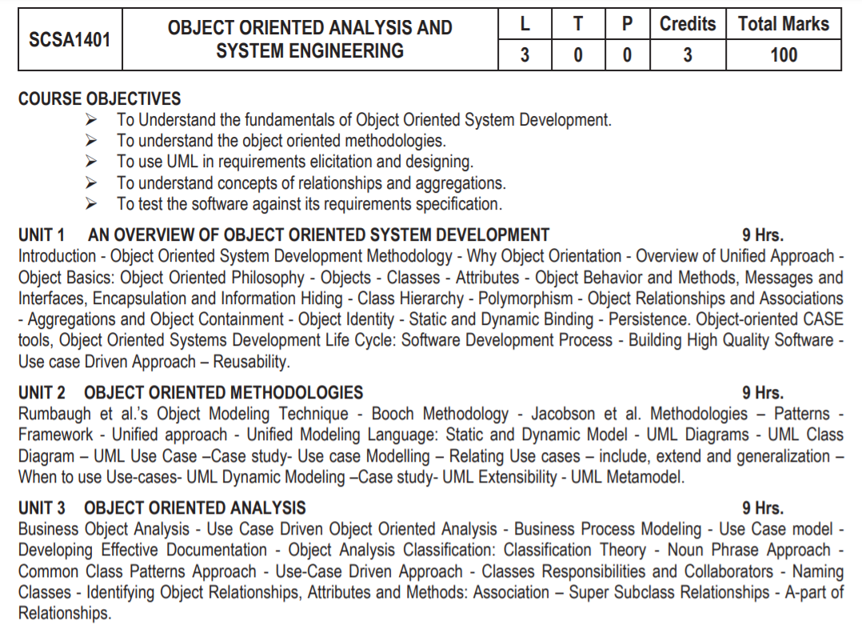

Slide 3
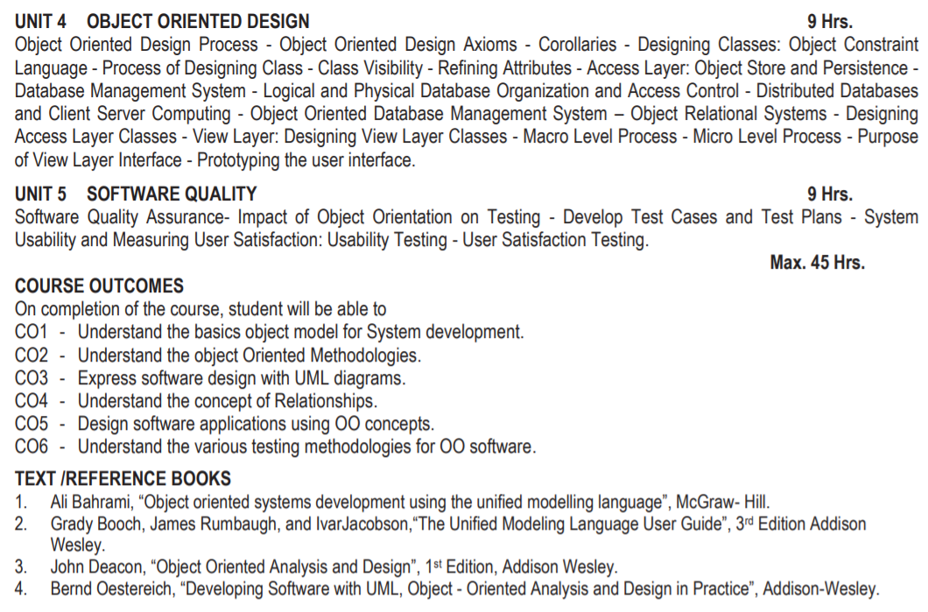

Slide 4
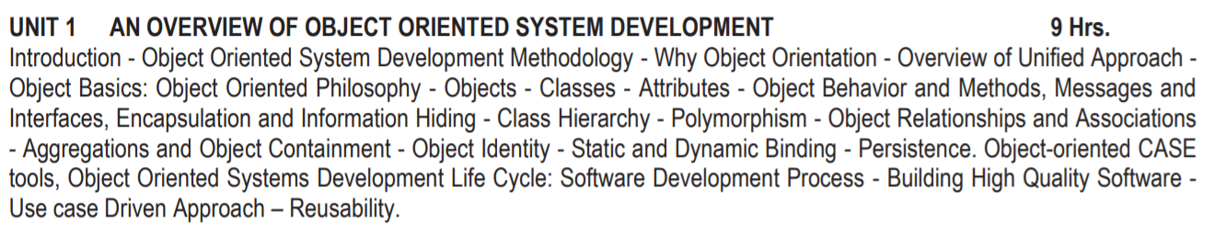

Slide 5
COURSE OUTCOMES
CO1 - Understand the basic object model for software development
CO2 - Understand the Object Oriented Methodologies
CO3 - Express software design with UML diagrams
CO4 - Understand the concept of Relationships
CO5 - Design software applications
CO6 - Understand the various testing methodologies for OO software

Slide 6
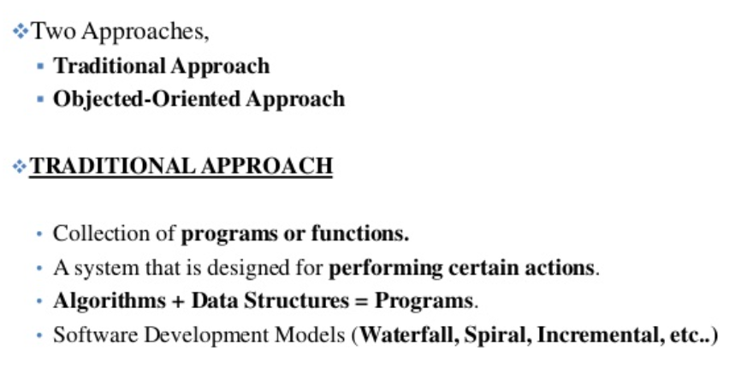
Orthogonal Views of Software
Structured Analysis and Design Technique (SADT)

Slide 7
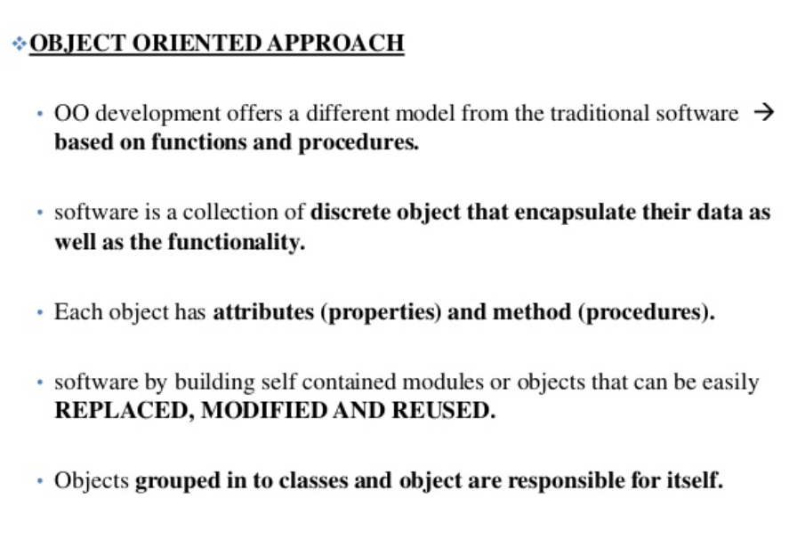

Slide 8
Object-Oriented System Development
OO System Development involves:
- OOA Using an OO approach to system analysis
OOD
Using an OO approach to system design
OOP
Using an OO approach to programming

Slide 9
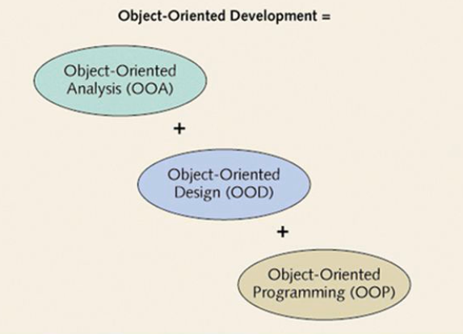
Object-Oriented System Development

Slide 10
Understanding OO Development
OO Approach
- System is defined as collection of OBJECTS that work together to accomplish task
- Each object maintains its own data
- Objects carry out actions when asked
Procedural Approach
- System is defined as a set of PROCEDURES that interact with data
- Data is maintained separately from procedures

Slide 11
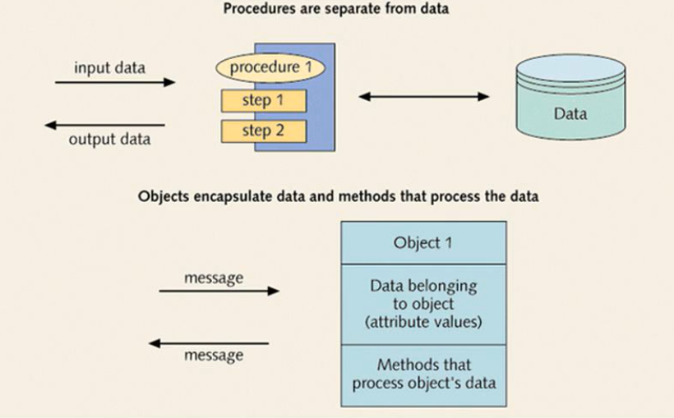

Slide 12
Why Object-Oriented?
“The "software crises" came about when people realized the major problems in software development were caused by communication difficulties and the management of complexity”
What kind of language can alleviate difficulties with communication & complexity hopefully well?
Communication & complexity about the problem and the solution, all expressed in terms of concepts in a language!
But then, What is CONCEPT?
Consider Human Growth & Concept Formation
Stage | Concepts
infant | the world is a buzzing confusion
very young age | "blue" "sky“ (individual concepts) "blue sky“ (more complex concept)
getting older | -> increased meaning, precision, subtlety, ... the sky is blue only on cloudless days the sky is not really blue it only looks blue from our planet Earth because of atmospheric effects elaborate conceptual constructs

Slide 13
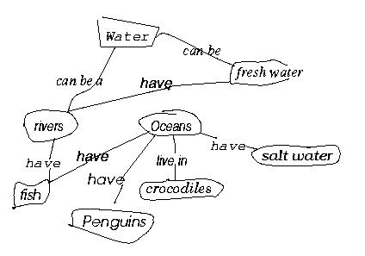
Why Object-Oriented? - concepts and objects
What is CONCEPT?
When given a list of concepts (water, salt water, Oceans, Penguins,...), Harry constructed a concept diagram through which he understands his world and communicates meaning

Slide 14
Why Object-Oriented? … for Conceptual … Modeling Reasons
What kind of language can be used to create this concept diagram, or Harry’s mental image?
Water
Fresh water
have
Rivers
Oceans
have
have
live in
Salt water
have
Crocodiles
Fish
have
Penguins

Slide 15
Why Object-Oriented -> What is a model and why?
A model is a simplification of reality.
E.g., a miniature bridge for a real bridge to be built
A model is our simplification of our perception of reality
A model is an abstraction of something for the purpose of understanding, be it the problem or a solution.
To understand why a software system is needed, what it should do, and how it should do it.
To communicate our understanding of why, what and how.
To detect commonalities and differences in your perception, my perception, his perception and her perception of reality.
To detect misunderstandings and miscommunications.

Slide 16
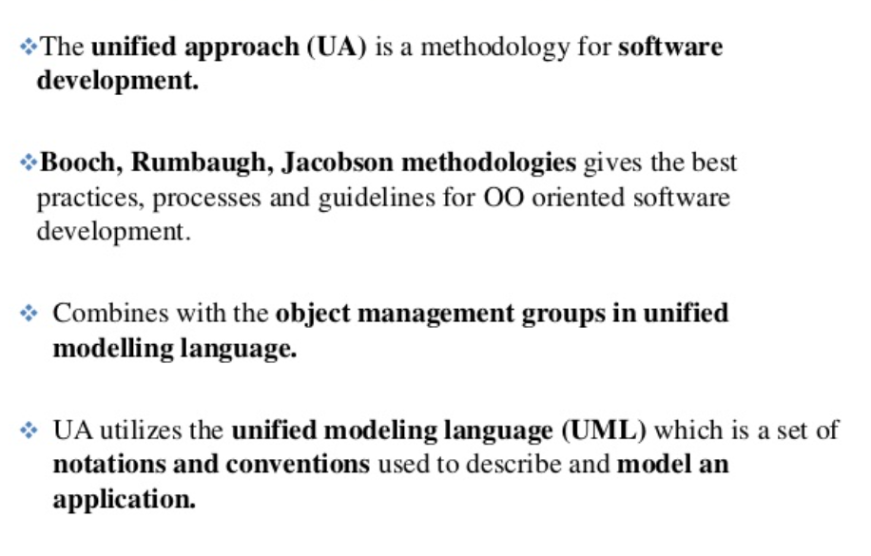
Overview of Unified Approach

Slide 17
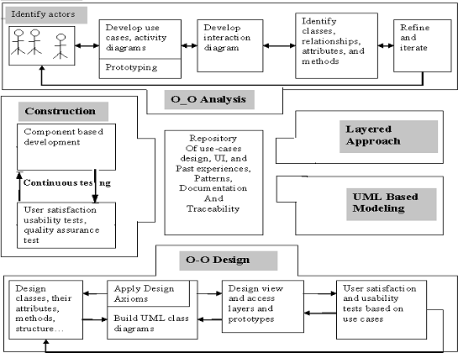
Processes and Components of UA

Slide 18
The UA consists of the following concepts:
Usecase driven approach
Utilizing the UML for modeling
Object oriented analysis
Object oriented design
Repositories of reusable classes and maximum reuse
The layered approach
Incremental development and prototyping
Continuous testing

Slide 19
1. Use-case driven development
The use case represents a typical interaction between a user and a computer system to capture the users‟ goals and needs.
2. Object-Oriented Analysis
Analysis is the process of extracting the needs of a system and what the system must do to satisfy the users‟ requirements. OOA process consists of the following steps:
Identify the Actors.
Develop a simple business process model using UML Activity diagram.
Develop the Use Case.
Develop interaction diagrams.
Identify classes.

Slide 20
3. Object-Oriented Design
OOD Process consists of:
Designing classes, their attributes, methods, associations, structures and protocols, apply design axioms
Design the Access Layer
Design and prototype User interface
User Satisfaction and Usability Tests based on the Usage/Use Cases
Iterated and refine the design
4. Iterative Development and Continuous Testing
Iterate and reiterate until, eventually, you are satisfied with the system.
During this iterative process, your prototypes will be incrementally transformed into the actual application.
Usability testing is the process in which the functionality of software is measured.

Slide 21
What are the building blocks of UML?
Things, relationships and diagrams are three building blocks of UML. Thing is nothing but any real-world entity.
Relationships are used to describe the connection between one or more things.
Various UML diagrams are used to describe different aspects of a single system.
Why are UML diagrams used?
The main aim of UML is to define a standard way to visualize the way a system has been designed. It is quite similar to blueprints used in other fields of engineering.
UML is not a programming language, it is rather a visual language. We use UML diagrams to portray the behavior and structure of a system.

Slide 22
Object oriented development
In Object-Oriented Development, we apply object orientation across every system development activity such as requirement analysis, design, programming, testing, and maintenance. For instance, an object oriented analysis (OOA) will usually have the following steps:
Identifying the system functionality
Identifying the involved objects
Recognizing the object classes
Analyzing the objects to fulfil the system functionality
Object-Oriented Programming (OOP) is based on object oriented features like Encapsulation, Polymorphism, Inheritance and Abstraction. These features are usually referred to as the OOPs concepts.

Slide 23
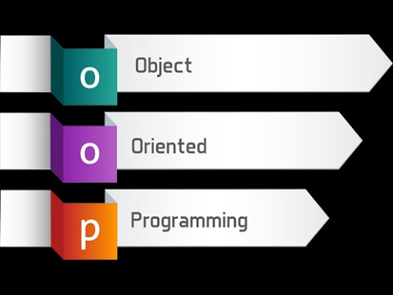
OOP Concepts
What is object-oriented programming?
Combines a group of variables (properties) and functions (methods) into a unit called an "object.“
These objects are organized into classes where individual objects can be grouped together.
OOP can help you consider objects in a program's code and the different actions that could happen in relation to the objects.
This programming style widely exists in commonly used programming languages like Java, C++ and PHP.
Programmers often use OOP when they need to create complex programs.

Slide 24
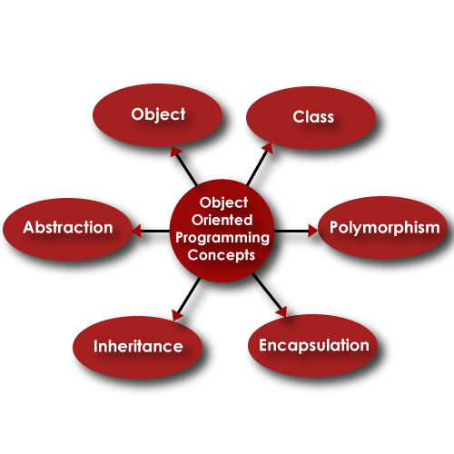
What are the basics of object-oriented programming?
Understanding the general framework of how they work will help you understand the basics of a computer program.
Object
Class
Encapsulation
Abstraction
Inheritance
Polymorphism

Slide 25

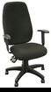
1. Object
An "object" is anything to which a concept applies.
Things drawn from the problem domain or solution space.
E.g., a living person in the problem domain, a software component in the solution space.
A structure that has identity and properties and behavior
It is an instance of a collective concept, i.e., a class.

Slide 26
Class
A class is a collection of method and variables. It is a blueprint that defines the data and behavior of a type.
Considering HumanBeing a class, which has properties like hands, legs, eyes, mouth, etc, and functions like walk, talk, eat, see, etc.

Slide 27
3. Encapsulation
The different objects inside of each program will try to communicate with each other automatically. If a programmer wants to stop objects from interacting with each other, they need to be encapsulated in individual classes. Through the process of encapsulation, classes cannot change or interact with the specific variables and functions of an object.
Mechanism for wrapping the data (variables) and code acting on the data (methods) together as a single unit. In encapsulation, the variables of a class will be hidden from other classes and can be accessed only through the methods of their current class. Therefore, it is also known as data hiding.
To achieve encapsulation in Java −
Declare the variables of a class as private.
Provide public setter and getter methods to modify and view the variables values.

Slide 28
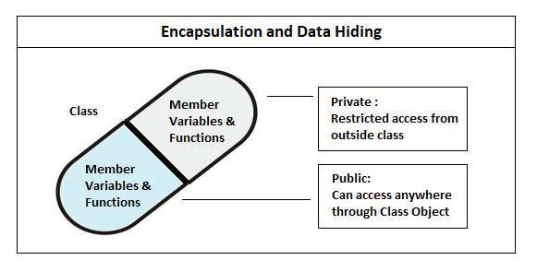
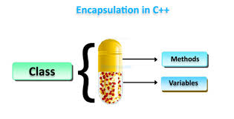

Slide 29
4. Abstraction
Abstraction is like an extension of encapsulation because it hides certain properties and methods from the outside code to make the interface of the objects simpler. Programmers use abstraction for several beneficial reasons. Overall, abstraction helps isolate the impact of changes made to the code so that if something goes wrong, the change will only affect the variables shown and not the outside code.
Abstraction is a process of hiding the implementation details from the user, only the functionality will be provided to the user. In other words, the user will have the information on what the object does instead of how it does it.
Abstraction allows the programmer to focus on few concepts at a time. In Java, abstraction is achieved using Abstract classes and interfaces.

Slide 30
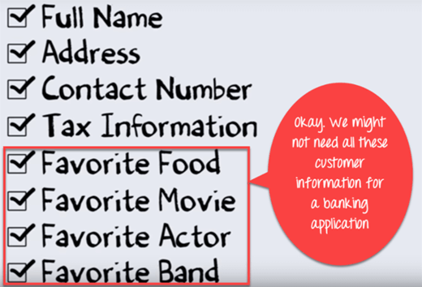

Slide 31
5. Inheritance
Using this concept, programmers can extend the functionality of the code's existing classes to eliminate repetitive code. For instance, elements of HTML code that include a text box, select field and checkbox have certain properties in common with specific methods.
Instead of redefining the properties and methods for every type of HTML element, you can define them once in a generic object. Naming that object something like "HTMLElement" will cause other objects to inherit its properties and methods so you can reduce unnecessary code.
The main object is the superclass and all objects that follow it are subclasses. Subclasses can have separate elements while adding what they need from the superclass.
Inheritance can be defined as the process where one (parent/super) class acquires the properties (methods and fields) of another (child/sub). With the use of inheritance, the information is made manageable in a hierarchical order.

Slide 32
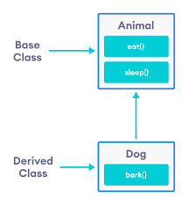
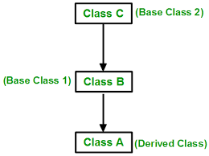

Slide 33
6. Polymorphism
This technique meaning “many forms or shapes”.
This concept allows programmers to redefine the way something works by changing how it is done or by changing the parts in which it is done. Terms of polymorphism are called overriding and overloading.
Polymorphism is the ability of an object to perform different actions (or, exhibit different behaviors) based on the context.

Slide 34
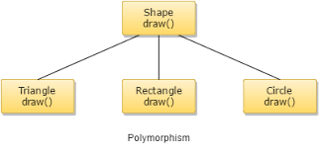
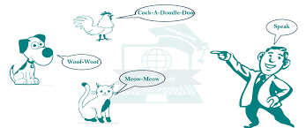

Slide 35
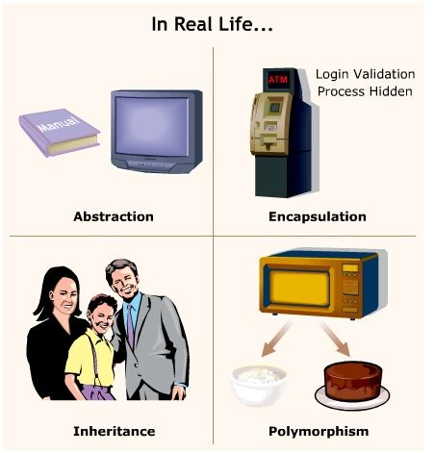

Slide 36
Coupling vs Cohesion
Coupling and cohesion are two important concepts in the Object Oriented design .
Coupling refers to the degree of direct knowledge that one element has of another. In other words, how often do changes in class A force related changes in class B.
Cohesion refers to what the class (or module) can do. It indicates the degree to which a class has a single, well-focused purpose.

Slide 37
Types of coupling:
Tight coupling : Two classes often change together.
The tightly coupled object is an object that needs to know about other objects and is usually highly dependent on each other's interfaces.
Changing one object in a tightly coupled application often requires changes to a number of other objects.
2. Loose Coupling
Loose coupling is a design goal to reduce the inter-dependencies between components of a system with the goal of reducing the risk that changes in one component will require changes in any other component.
Loose coupling is a much more generic concept intended to increase the flexibility of the system, make it more maintainable and makes the entire framework more stable.
Note: Loose coupling and High cohesion are desirable, whereas tight coupling and less cohesion can lead you to problems in the long run.

Slide 38
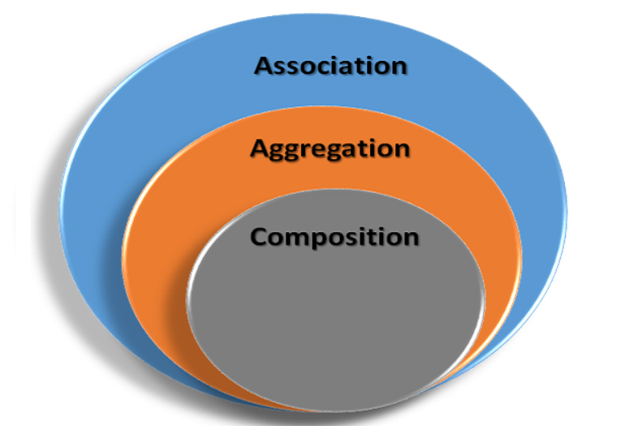
Association, Aggregation, and Composition in OOSD
In UML there are five different types of relationships:
Association
Aggregation
Composition
Dependency
Inheritance

Slide 39
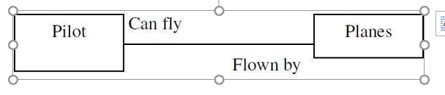
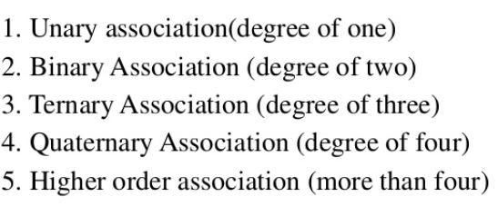
Object Relationship and Association
Association depicts the relationship between objects of one or more classes. A link can be defined as an instance of an association.
Degree of an Association
It denotes the number of classes involved in a connection.
A unary relationship connects objects of the same class.
A binary relationship connects objects of two classes.
A ternary relationship connects objects of three or more classes.

Slide 40
Cardinality Ratios of Associations
Cardinality of a binary association denotes the number of instances participating in an association. There are three types of cardinality ratios,
One–to–One − A single object of class A is associated with a single object of class B.
Ex: Person and Passport
One–to–Many − A single object of class A is associated with many objects of class B. Ex: Owners and Pets
Customer and Order
Many–to–Many − An object of class A may be associated with many objects of class B and conversely an object of class B may be associated with many objects of class A.
Ex: Doctor and Patient

Slide 41
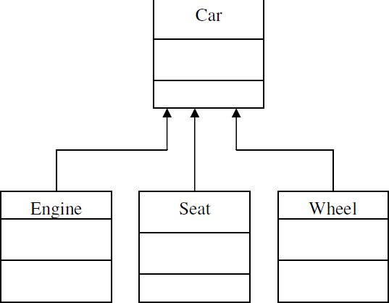
Aggregation or Composition
Aggregation refers to a class can be made up of any combination of objects of other classes. It allows objects to be placed directly within the body of other classes. Aggregation is referred as a “part–of” or “has–a” relationship, with the ability to navigate from the whole to its parts. An aggregate object is an object that is composed of one or more other objects.
Example
In the relationship, “a car has–a motor”, car is the whole object or the aggregate, and the motor is a “part–of” the car.

Slide 42
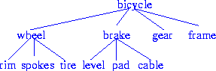
Object Containment
Objects that contain other objects are called complex or composite objects. There can be multiple levels of containment, forming a containment hierarchy among objects.
Example: A bicycle design database:
Containment hierarchy for bicycle-design
Containment allows data to be viewed at different granularities by different users.
E.g., wheel by wheel designer but bicycle by a sales-person. The containment hierarchy is used to find all objects contained in a bicycle object.
Creditcard object contains Billinginfo, which in turn contains Address object.

Slide 43
object identity
With object identity, objects can contain or refer to other objects. Identity is a property of an object that distinguishes the object from all other objects in the application.
All the objects have a state, behavior and identity.
State of an object - The state or attributes are the built in characteristics or properties of an object. For example, a T.V has the size, colour, model etc.
Behavior of the object - The behavior or operations of an object are its predefined functions. For example, a T.V. can show picture, change channels, tune for a channel etc. in object oriented programming terminology the behavior is implemented through methods.
Object identity - Each object is uniquely identifiable. For example, the fridge can not become the T.V.

Slide 44
Object identity: An object retains its identity even if some or all of the values of variables or definitions of methods change over time.
Object identity is a stronger notion of identity than typically found in programming languages or in data models not based on object orientation.
Several forms of identity:
value: A data value is used for identity (e.g., the primary key of a tuple in a relational database).
name: A user-supplied name is used for identity (e.g., file name in a file system).
built-in: A notion of identity is built-into the data model or programming languages, and no user-supplied identifier is required (e.g., in OO systems).
Object identity is typically implemented via a unique, system-generated OID. The value of the OID is not visible to the external user, but is used internally by the system to identify each object uniquely and to create and manage inter-object references.
There are many situations where having the system generate identifiers automatically is a benefit, since it frees humans from performing that task. However, this ability should be used with care. System-generated identifiers are usually specific to the system, and have to be translated if data are moved to a different database system. System-generated identifiers may be redundant if the entities being modeled already have unique identifiers external to the system, e.g., SIN#.

Slide 45
Static and Dynamic Binding:
Association of method call to the method body is known as Binding. This is directly related to execution of code.
Types of binding:
Static Binding that happens at compile time. Its also known as Early Binding.
Dynamic Binding that happens at runtime. Its also known as Late Binding.

Slide 46
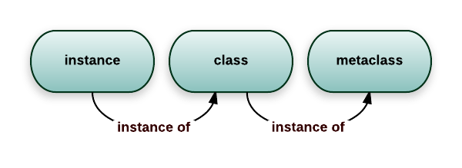
Object Persistence:
Objects have a lifetime.
They are explicitly created and can exist for a period of time that has been the duration of the process in which they were created.
A file or database can provide support for objects having a longer lifeline, longer than the duration of the process for which they are created.
This characteristic is called object persistence.
Meta-Classes:
In an object-oriented system every thing is an object, what about a class? Is a class an object?. Yes, a class is an object.
So, If it is an object, it must belong to a class, such a class belong to a class called a meta-class (or) class or classes.

Slide 47
Building high quality software
Quality :
By identifying,
Process – Transforms needs into software solution
Product – Upto the customer needs and expectation
The quality can be measured either by Customer needs/Minimal or no defects

Slide 48
Building high quality software
Two Perspectives:-
Blum – 2 measures used to check quality
Boehm -
Goal is user satisfaction. To achieve high quality software we need to be able to answer the following question.
how do we determine system is ready for delivery
is it now an operational system that satisfies users’needs
is it correct and operating as we thought it should ?
Does it pass an evaluation process ?
Approaches to systems testing
Test according to
how it has been built
what it should do

Slide 49
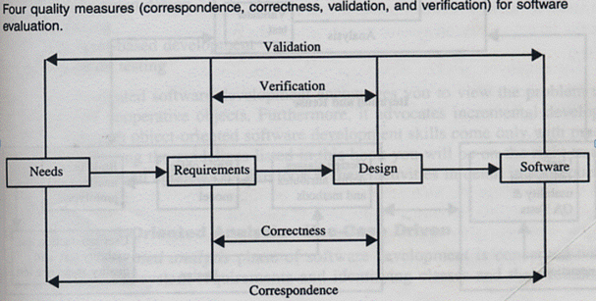
There are different approaches for systems testing. Blum describes a means of system evaluation in terms of four quality measures,
Correspondence
Correctness
Verification and
Validation

Slide 50
4 quality measures
correspondence
measures how well delivered system matches needs of operational environment, as described in original requirements statement
validation
task of predicting correspondence (true correspondence only determined after system is in place)
correctness
measures consistency of product requirements with respect to design specification
verification
exercise of determining correctness (correctness objective => always possible to determine if product precisely satisfies requirements of specification)

Slide 51
Verification vs Validation
Verification
am I building the product right ?
Begin after specification accepted
Validation
am I building the right product ?
Begins as soon as project starts
Verification & validation independent of each other
even if product follows spec, it may be a wrong product if specification is wrong
eg: report missing, initial design no longer reflect current needs
Verification vs Validation
Definition
Execution of code
Who perform it?
Activities Involved
Which activity take place first?
Cost of fixing
What is evaluated
Main aim

Slide 52
Object-oriented approach: A use-case driven approach
Object-oriented software development life cycle consists of
Object-oriented analysis
Object-oriented design
Object-oriented implementation
Use-case model can be employed throughout most activities of software development
designs traceable across requirements, analysis, design, implementation & testing can be produced
all design decisions can be traced back directly to user requirements
usage scenarios can be test scenarios.

Slide 53
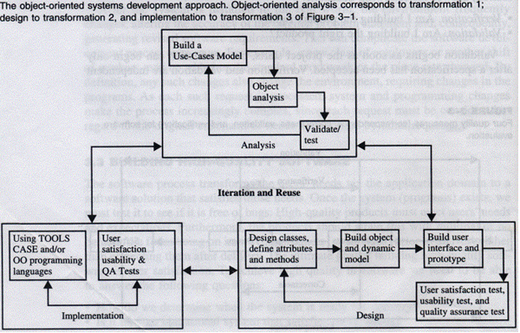
Object-oriented Systems Development Approach

Slide 54
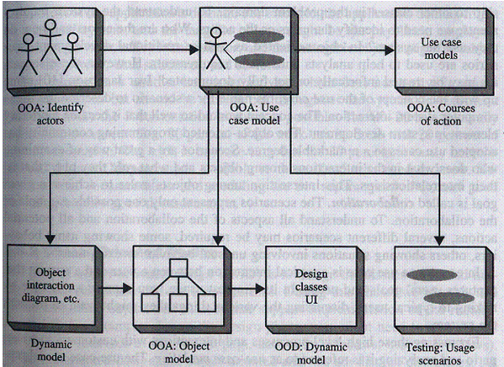
Using Jacobson et al. life cycle model – traceable design across development

Slide 55
Object-Oriented Software Development
Activities
Object-oriented analysis - use case driven
Object-oriented design
Prototyping
Component-based development
Incremental testing
Encourages
Viewing of system as a system of cooperative objects
Incremental development

Slide 56
Object-oriented analysis - use-case driven
Use Case, is a name for a scenario to describe the user–computer system interaction.
Determine system requirements, identify classes & their relationship to other classes in domain
To understand system requirements
need to identify the users or actors
who are the actors ? How do they use system ?
Scenarios can help (in traditional development, it is treated informally, not fully documented)
Jacobson introduces concept of use case - scenario to describe user- computer system interaction

Slide 57
Use case
Typical interaction between user & system that captures users’ goal & needs
In simple usage, capture use case by talking to typical users, discussing various things they might want to do with system
Can be used to examine who does what in interactions among objects, what role they play, intersection among objects’ role to achieve given goal is called collaboration
Several scenarios (usual & unusual behavior, exceptions) needed to understand all aspects of collaboration & all potential actions

Slide 58
use cased modeling
expressing high level processes & interactions with customers in a scenario & analyzing it
gives system uses, system responsibilities
developing use case is iterative
when use case model better understood & developed, start identifying classes & create their relationship

Slide 59
Identifying objects
What are physical objects in system ?
Individuals,organizations, machines, units of information, pictures, whatever makes up application/ make sense in context of real world
objects help establish workable system
work iteratively between use-case & object models
incentive payroll - employee, supervisor, office administrator, paycheck, product made, process used to make product
Intangible objects ?
Data entry screens, data structures

Slide 60
Documentation
– 80-20 rule
80% work can be done with 20% documentation
20% easily accessible, 80% availbel to few who needs to know
modeling & documentation inseparatable
good modeling implies good documentation

Slide 61
Object-oriented Design
Goal : to design classes identified during analysis phase & user interface
Identify additional objects & classes that support implementation of requirements
Eg. add objects for user interface to system (data entry windows, browse windows)
Can be intertwined with analysis phase
Highly incremental, eg. can start with object-oriented analysis, model it, create object-oriented design, then do some more of each again & again, gradually refining & completing models of system
Activities & focus of oo analysis & oo design are intertwined, grown not built

Slide 62
Object-oriented Design
First, build object model based on objects & relationship
Then iterate & refine model
Design & refine classes
Design & refine attributes
Design & refine methods
Design & refine structures
Design & refine associations

Slide 63
Guidelines in Object-oriented Design
Reuse rather than build new classes
Know existing classes
Design large number of simple classes rather than small number of complex classes
Design methods
Critique what has been proposed
- Go back & refine classes

Slide 64
Prototyping
Prototype – version of software product developed in early stages of product’s life cycle for specific, experimental purposes
Enables us to fully understand how easy/difficult it will be to implement some features of system
Gives users chance to comment on usability & usefulness of user interface design
Can assess fit between software tools selected, functional specification & user needs
Can further define use cases, makes use case modeling easier
prototype that satisfies user + documentation -> define basic courses of action for use cases covered by prototype.
Important to construct prototype of key system components shortly after products are selected
Pictures worth a thousand words
Build prototype with use-case modeling to design systems that users like & need

Slide 65
Prototyping: old & new
Before: prototype thrown away when industrial strength version developed
New trend: (eg. rapid application development) prototype refined into final product
Prototype used as means to test & refine user interface & increase usability of system
As underlying prototype design becomes more consistent with application requirements, more detail can be added to application
Test, evaluate & build further till all components work properly

Slide 66
Categories of Prototypes
Horizontal prototype (Not in depth but links to all screens on your navigation)
Simulation of interface (entire interface in full-featured system)
Contain no functionality
Quick to implement, provide good overall feel of system
Vertical prototype (Goes in depth in testing single feature/task)
Subset of system features with complete functionality
Few implemented functions can be tested in great depth
Hybrid prototypes
Major portions of interface established, features having high degree of risk are prototyped with more functionality

Slide 67
Developing prototypes
Typical time from few days to few weeks
Should be done parallel with preparation of functional spec
Can result in modification of spec (some problems/features only obvious after prototype built) Should involve representation from all user groups that will be affected by project
To ascertain all that the general structure of the prototype meets requirements established for overall design
Purpose of review
Demo that prototype has been developed according to spec & that final spec is appropriate
Collect info about errors & problems in systems, eg user interface problems.
Give management & everyone connected with project glimpse of what technology can provide
Evaluation easier if supporting data readily available
Testing considerations must be incorporated in design & implementation of systems

Slide 68
Implementation: Component-based development
No more custom development, now assemble from prefabricated components
No more cars, computers, etc custom designed & built for each customer
Can produce large markets, low cost, high quality products
Cost & time reduced by building from pre-built, ready-tested components
Value & differentiation gained by rapid customization to targeted customers

Slide 69
Component-based development
Industrialised approach to system development, move form custom development to assembly of pre-built, pre-tested, reusable software components that operate with each other
Application development improved significantly if applications assembled quickly from prefabricated software components
Increasingly large collection of interpretable software components could be made available to developers in both general & specialist catalogs
Components themselves can be constructed from other components, down to prebuilt components/old-fashioned code written in prg languages like C
Visual tools/actual code can be used to glue together components
Visual glue – Digitalk’s Smalltalk PARTS, IBM VisualAge
Less development effort, faster, increase flexibility

Slide 70
Rapid Application Development (RAD)
Set of tools & techniques to build application faster than typically possible with traditional methods
Often used with software prototyping
Iterational development
Implement design & user requirements incrementally with tools like Delphi, VisualAge, Visual Basic, or PowerBuilder
Begins when design completed
Do we actually understood problem (analysis) ?
Does the system do what it is supposed to do (design) ?
Make improvement in each iteration

Slide 71
Incremental testing
Software development and all of its activities including testing are an iterative process.
Waiting until after development waste money & time
Turning over applications to quality assurance group not helping since they are not included in initial plan

Slide 72
Reusability
Major benefit of Object-oriented approach
For objects to be reusable, much effort must be spent of designing it
Design reusability
Effectively evaluate existing software components
Has my problem been solved ?
Has my problem been partially solved ?
What has been done before to solve problem similar to this one ?

Slide 73
Need
detailed summary info about existing software components
Some kind of search mechanism
Define candidate object simply
Generate broadly/narrowly defined query
Reuse Strategy
Information hiding
Conformance to naming standards
Creation & administration of an object repository
Encouragement by strategic management of reuse as opposed to constant redevelopment
Establish target for % of object in project to be reuse

Slide 74
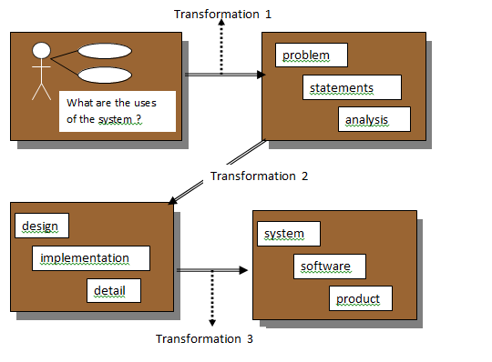
The SW Development Process :
System development can be viewed as a process
Development is a process of change, refinement, transformation, or addition to the existing product
Generally, the SW development process can be viewed as a series of transformations, where the output of one transformation becomes the input of the subsequent transformation.
SW process reflecting transformation from needs to a SW product that satisfies those needs

Slide 75
Transformation 1 (analysis) – translates the user’s needs into system requirements & responsibilities
Transformation 2 (design) – begins with a problem statement and ends with a detailed design that can be transformed into an operational system
Transformation 3 (implementation) – refines the detailed design into the system deployment that will satisfy the user’s needs
The emphasis on the analysis & design aspects of the SW life cycle, is intended to promote building high-quality SW (meeting the specifications and being adaptable for change )

Slide 76
THANK YOU

